Slide 1
Image Classifier
Explained for beginners
What is Classification? How images can be classified?

Slide 2
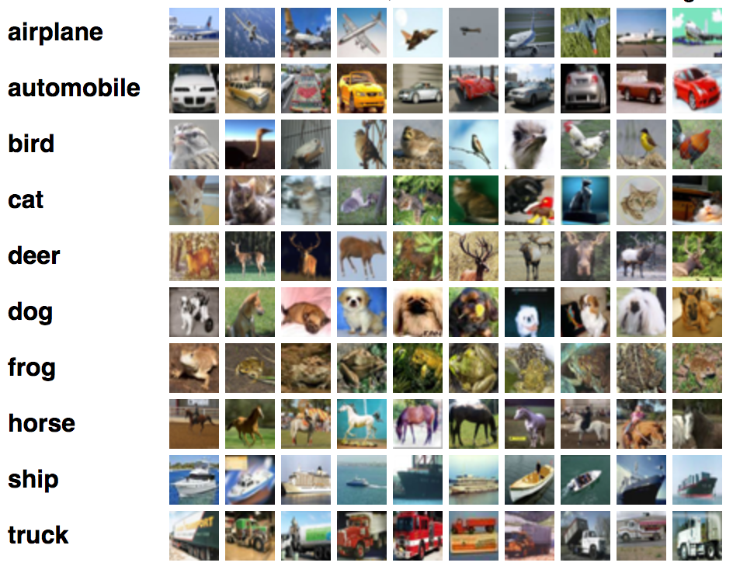
Image Classification

Slide 3
Image Classification Pipeline Main Focus
Feature Extraction
HOG
LBP

Slide 4
Image Classification Pipeline Main Focus
Feature Extraction
HOG
LBP
Classification Model
SVM
Neural Network

Slide 5
Image Classification Techniques Main Focus
Feature Extraction
HOG
LBP
Classification Model
SVM
Neural Network
Convolutional Neural Network
Feature Learning
Classification Model

Slide 6
Website : www.aisciences.net

